Slide 1


EDSSI Conference SSPs workshop
Thessaloniki, Greece
Date: | May 18th 2022
Presenter: | Bruno Pereira
The sole responsibility of this publication lies with the project consortium. The European Union is not responsible for any use that may be made of the information contained therein.
LC-01560120 CEF-TC-2019-4-001

Slide 2


SSPs module
Erasmus Dashboard
Learning Agreements
Default Data
IIA
Institutional Information
Student
Service Provider (SSP)
Module
Student
Data
Existing Module
External SSP Information
New Module

Slide 3




SSP Module Objectives
Dashboard collects all information regarding Student Services of the institutions
This information can be shared across multiple platforms.
Inserts its services information
External
SSP
HEI
Can be either…
Platform 1
Dashboard
SSP Database
Stores selection
Shares SSP information
Selects…
And chooses…
Platform 2
IRO
Service
Provider
Platform 3
HEIs may check SSP information of other HEIs

Slide 4
SSP Information Flow EWP Network Perspective
HEI with its own system
SSP’s (In-House, Public, Private)
EWP Registry
HEI using Dashboard
Erasmus App+
Communication through SSP APIs*
HEI represented by Commercial Software
*Every information owner provides its data to the rest of the network

Slide 5
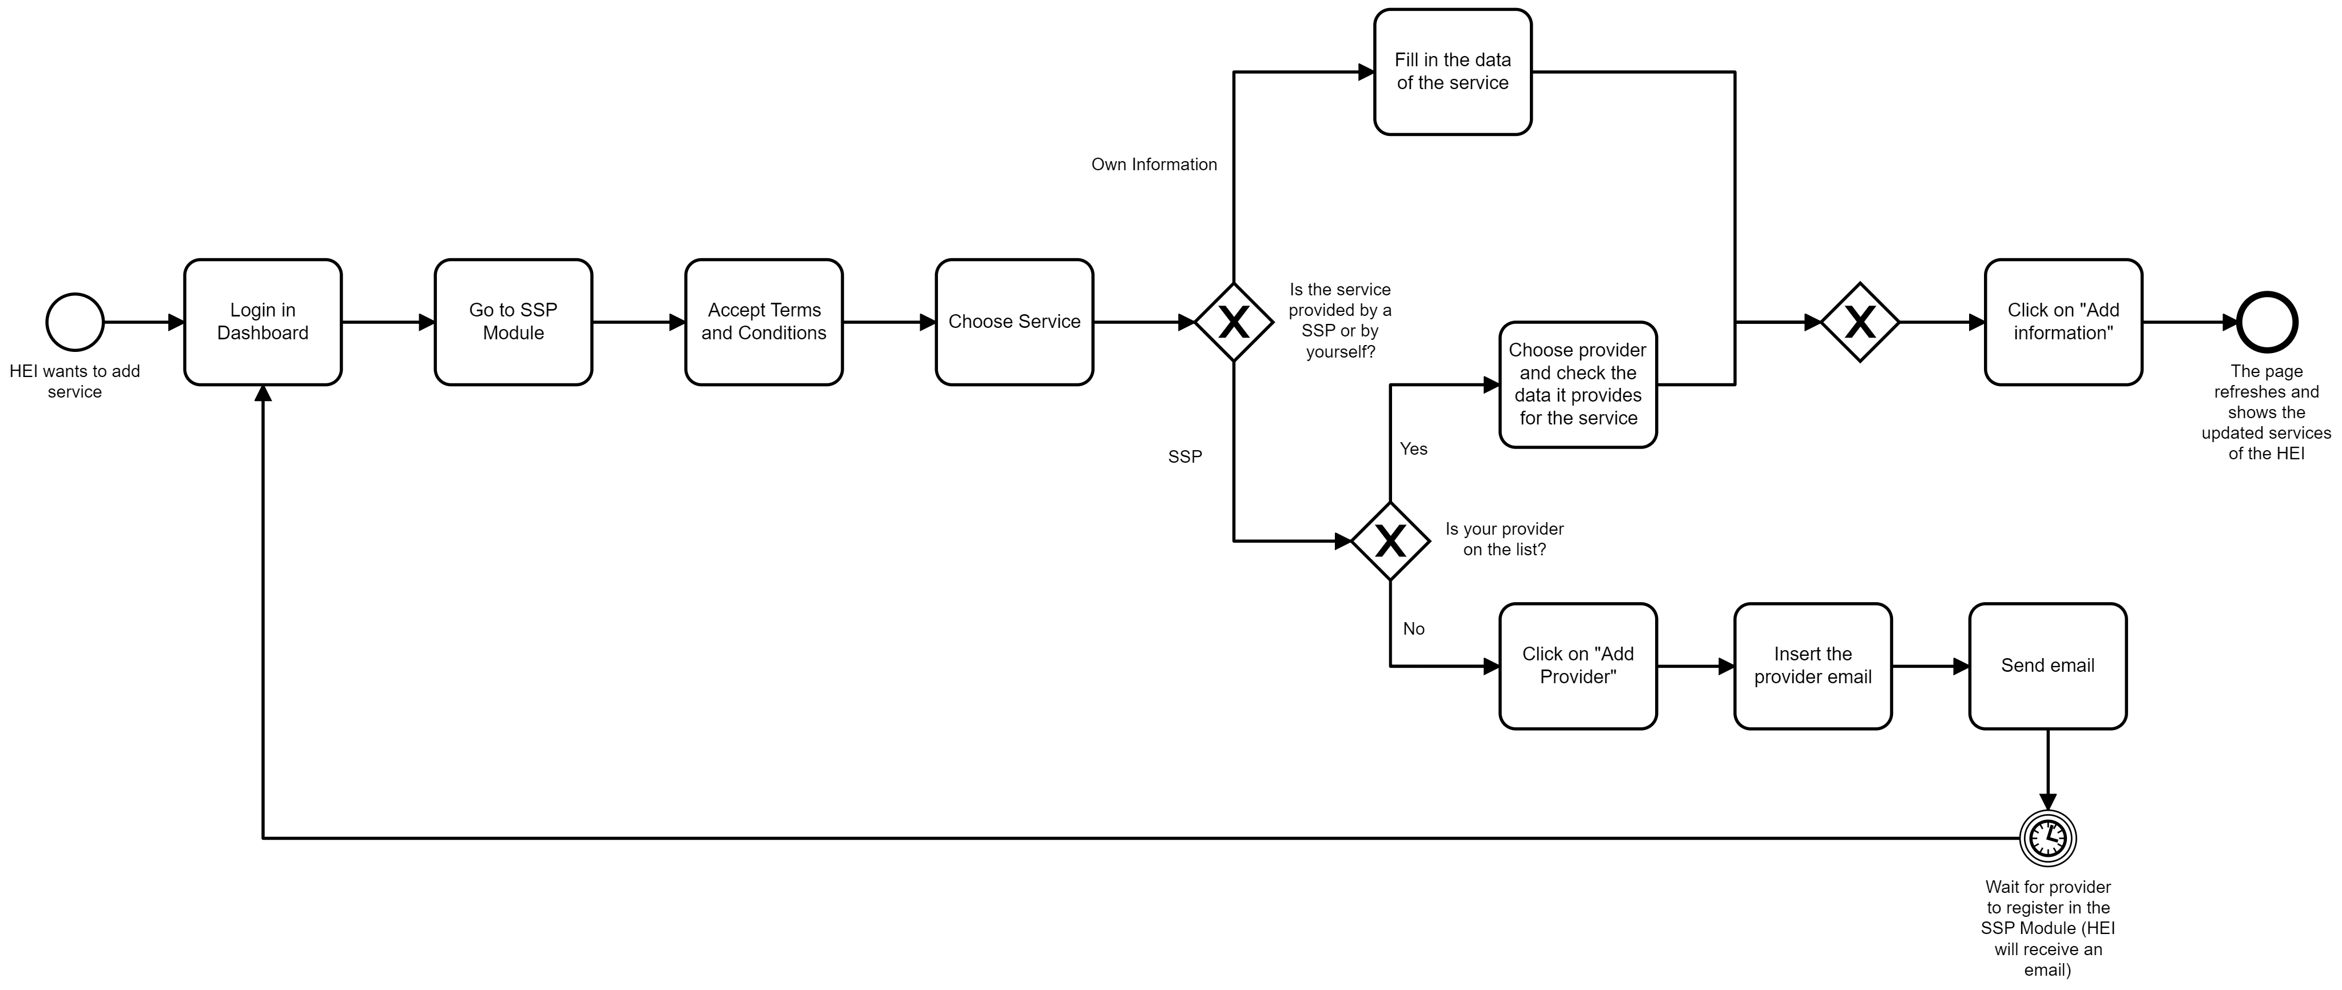
HEI Perspective

Slide 6
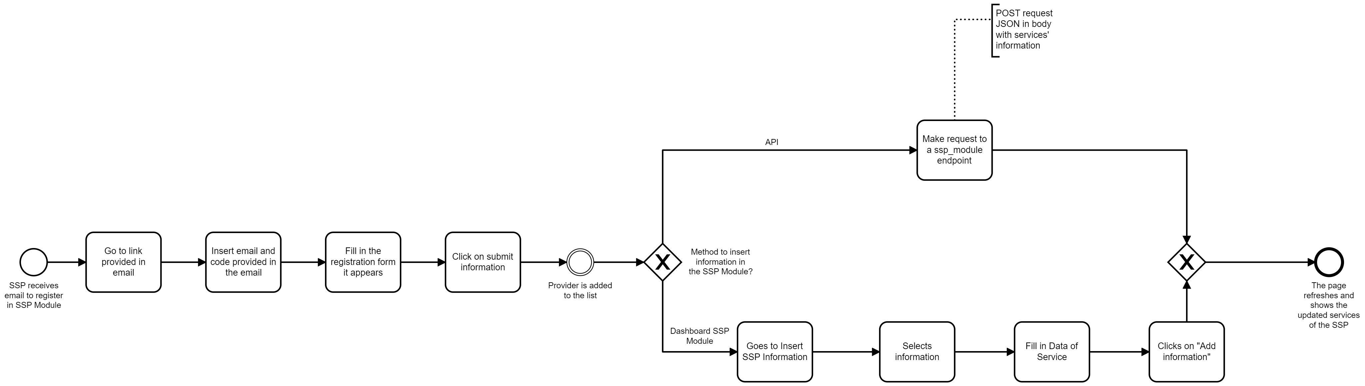
SSP Perspective

Slide 7
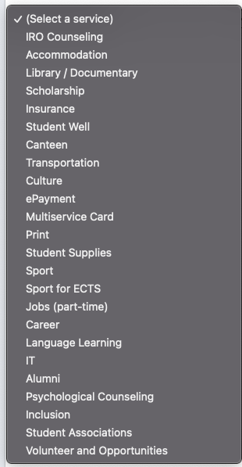
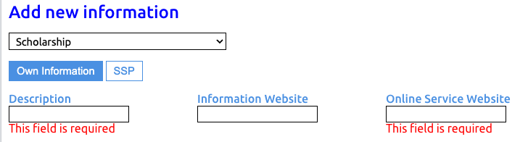
How can the IRO add service information?
Fig.1 - Fill in the information
Fig.2 – Selection of services

Slide 8
Test it yourself!
Login into: https://something-ewp.herokuapp.com;
username:
password:
Access on the left menu to the “SSP module”;
Insert information
Insert information provided by your HEI
Insert information provided by an already existing provider
Insert a new provider

Slide 9
Thank you
www.edssi.eu

